Slide 1
Capstone Project - 1 Crafting Compelling Web Presences
By
Rajanaveen Pasuvesan

Slide 3





Products we are going to cover

Slide 5


Slide 6
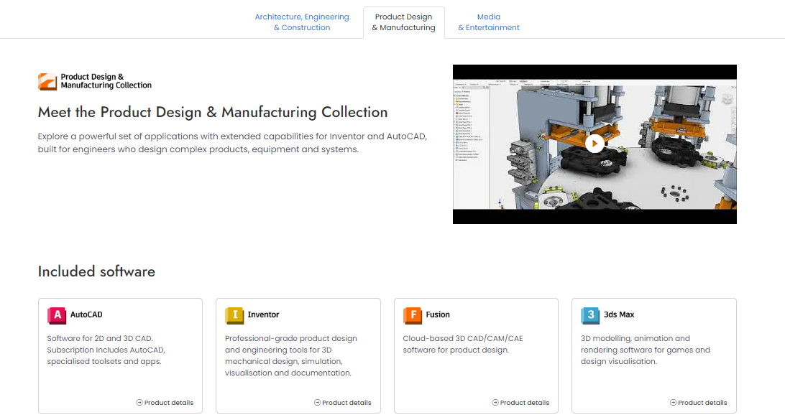

Slide 7
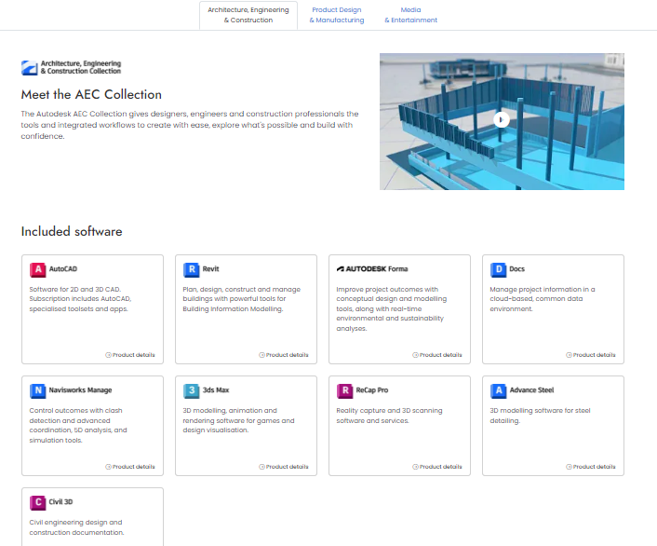

Slide 8
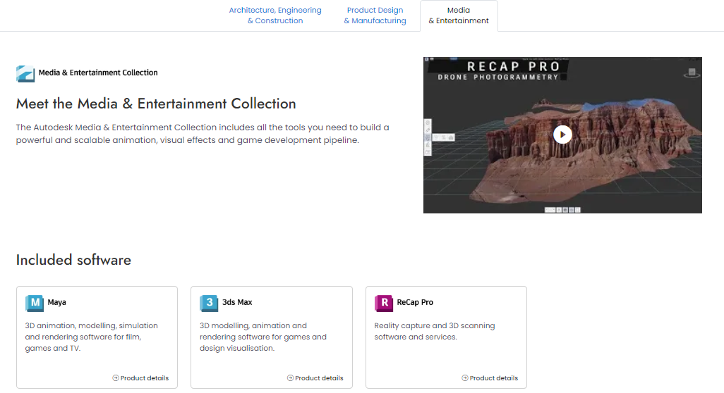

Slide 10
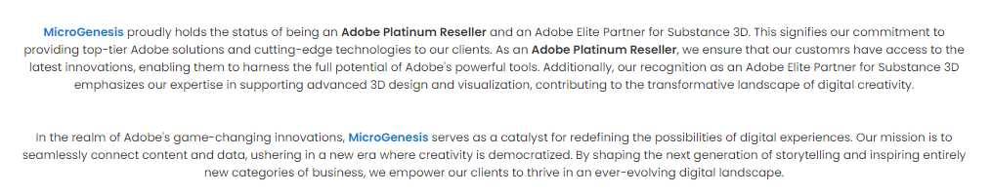

Slide 11
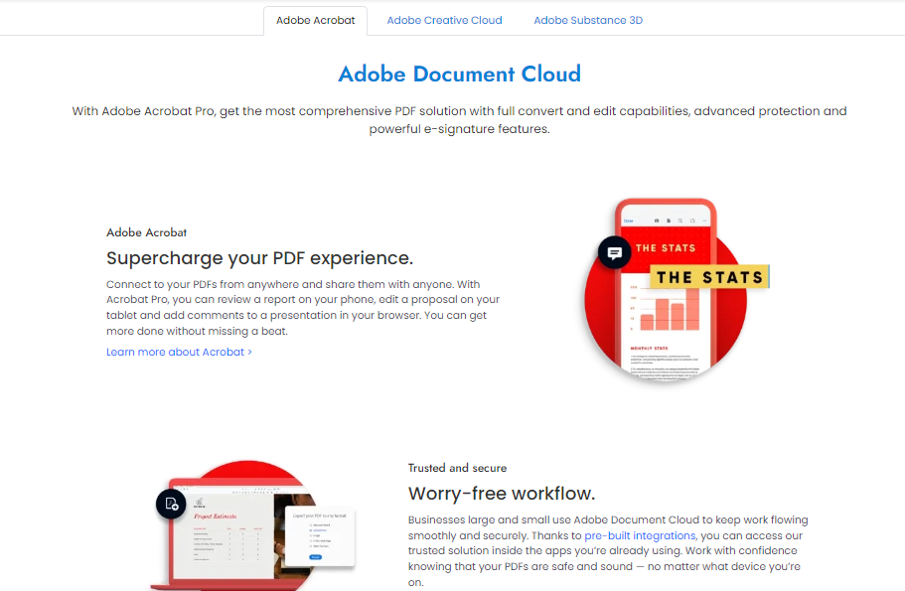

Slide 12
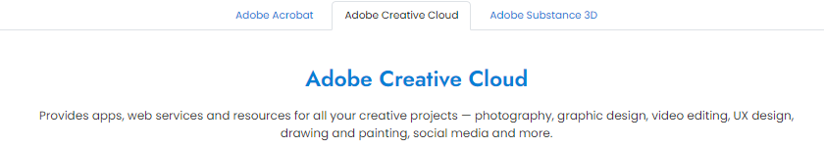
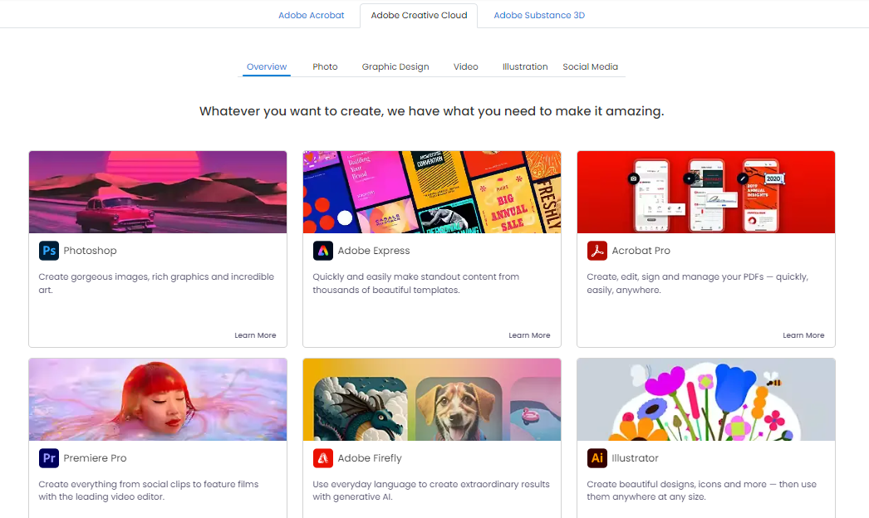

Slide 13
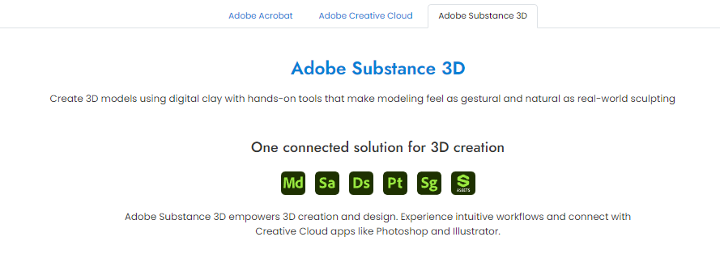

Slide 15
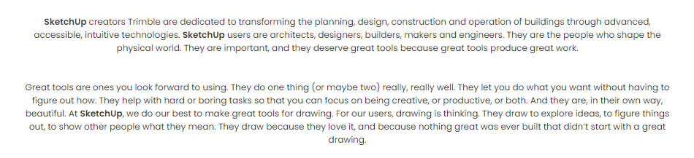

Slide 16
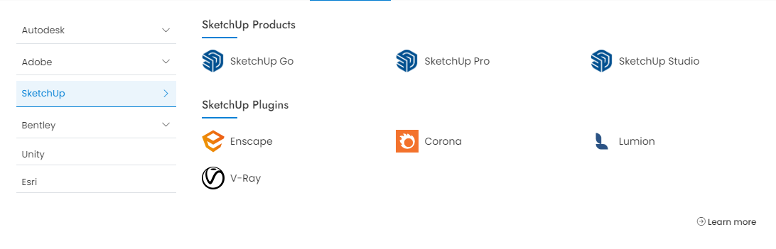

Slide 18
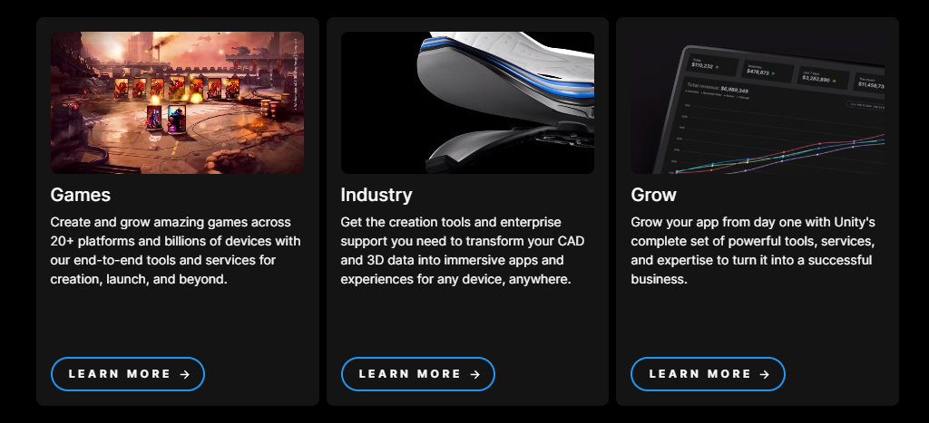

Slide 19
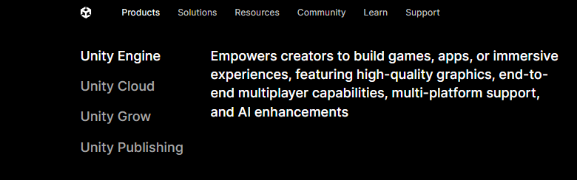

Slide 21


Slide 22
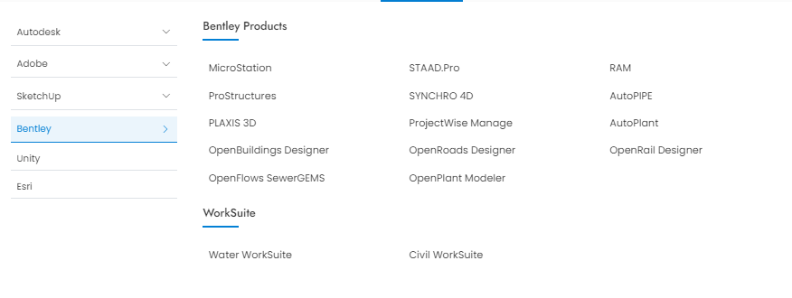

Slide 23
Determine the platform on which the website is developed (Use online tools to identify)

Slide 24

Tool Used

Slide 25
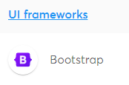

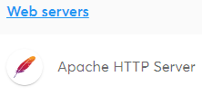
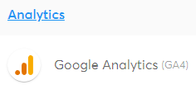
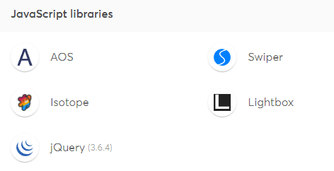
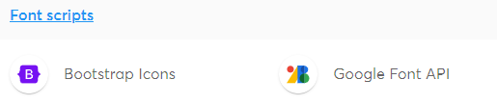
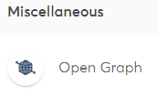


Slide 26
Test the website's responsive design and mobile optimization (Share the report). Test a minimum of 5 pages (Use Online Tools to find).

Slide 27
Tool Used
Google Chrome:
It offers a built-in feature that allows you to simulate how your website appears on various devices and scree sizes. Access it by right-clicking on your webpage, selecting “inspect”, the toggling the device toolbar.
Viewport Resizer:
Responsive design testing Google chrome.

Slide 28
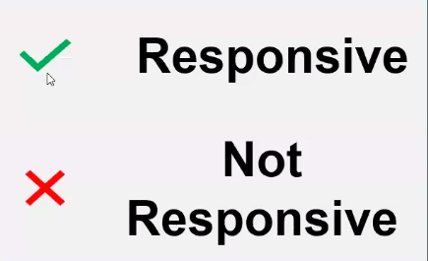
Page we are going test
Home Page
Product Pages(Autodesk)
Product Pages(Adobe)
Product Page( SketchUp)
Store

Slide 29

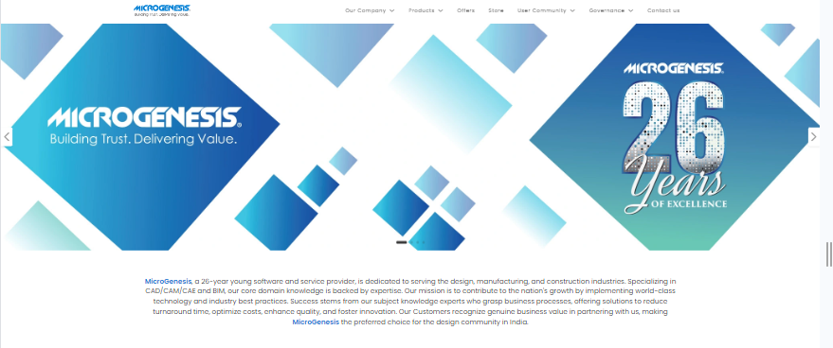
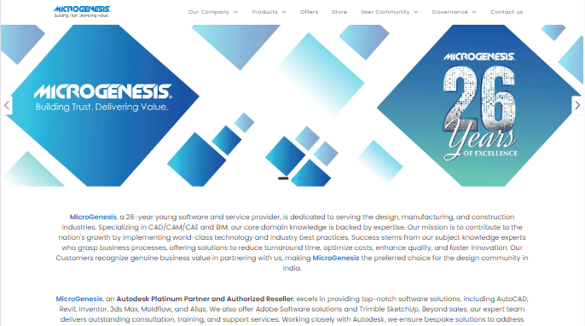
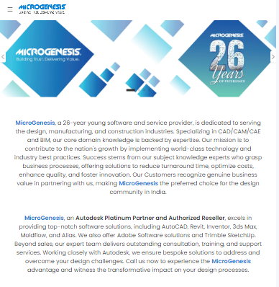

Desktop (Full Screen)
Width 1920 x 1200
Laptop (Full Screen)
Width 1366 x 768
Home Page
Tablet
Width 768 x 1024
Mobile
Width 375 x 667

Slide 30
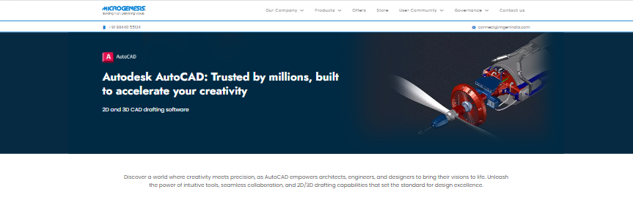
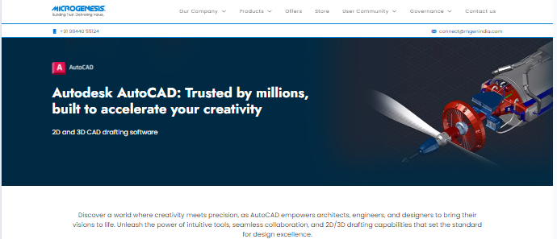
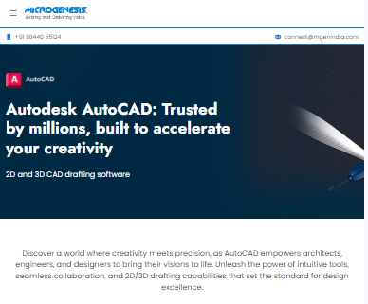

Desktop (Full Screen)
Width 1920 x 1200
Laptop (Full Screen)
Width 1366 x 768
Product Page
Tablet
Width 768 x 1024
Mobile
Width 375 x 667

Slide 31
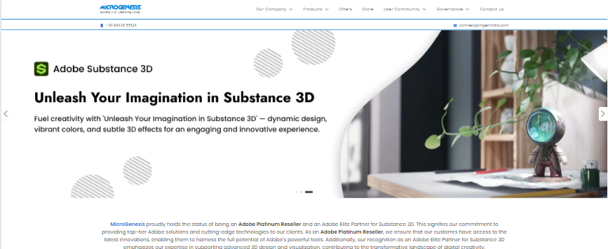
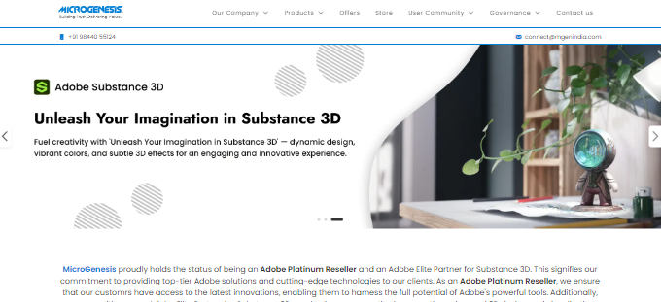
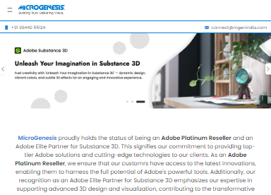
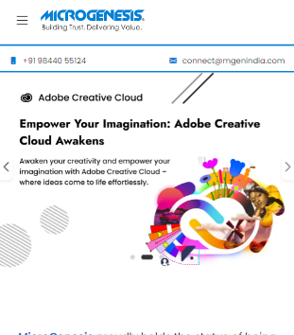
Desktop (Full Screen)
Width 1920 x 1200
Laptop (Full Screen)
Width 1366 x 768
Product Page
Tablet
Width 768 x 1024
Mobile
Width 375 x 667

Slide 32
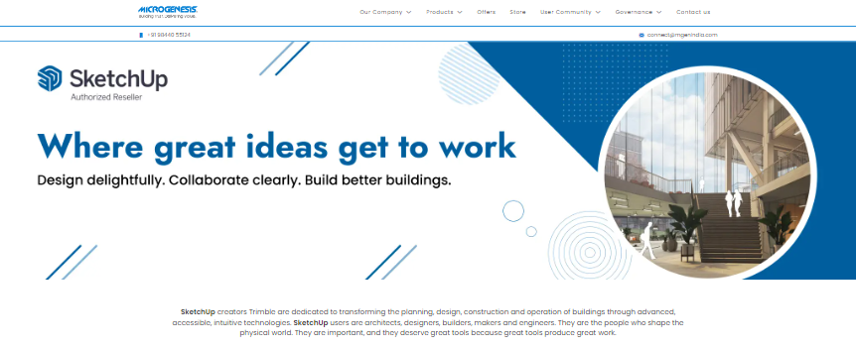
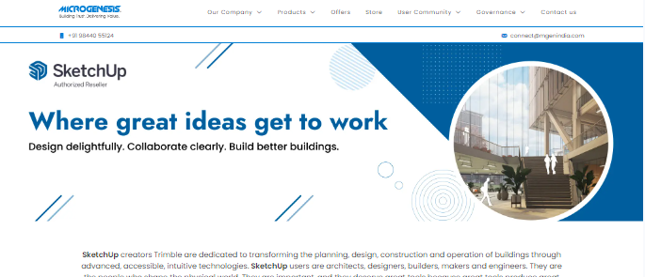
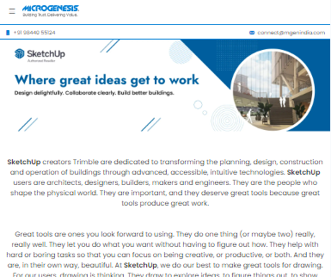
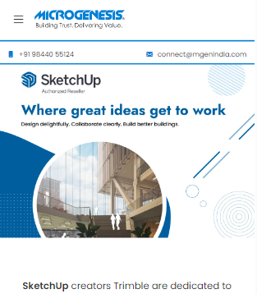
Desktop (Full Screen)
Width 1920 x 1200
Laptop (Full Screen)
Width 1366 x 768
Product Page
Tablet
Width 768 x 1024
Mobile
Width 375 x 667

Slide 33
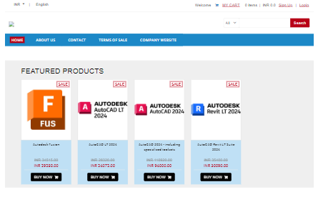
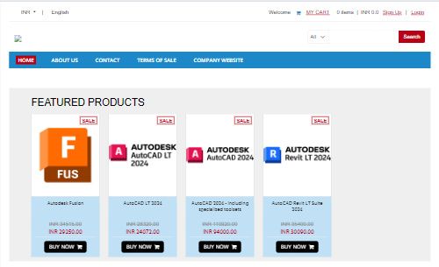
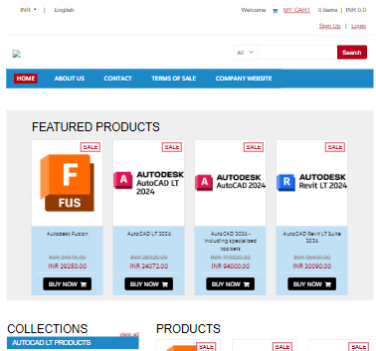
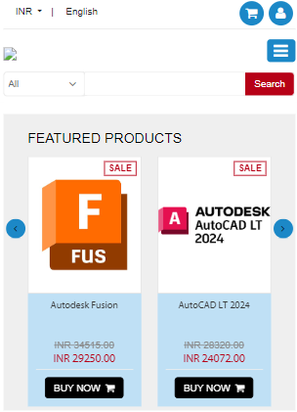
Desktop (Full Screen)
Width 1920 x 1200
Laptop (Full Screen)
Width 1366 x 768
Store Page
Tablet
Width 768 x 1024
Mobile
Width 375 x 667

Slide 34
Identify common website design mistakes to avoid, such as cluttered layouts and slow loading times. (List at least 5 suggestions)

Slide 35
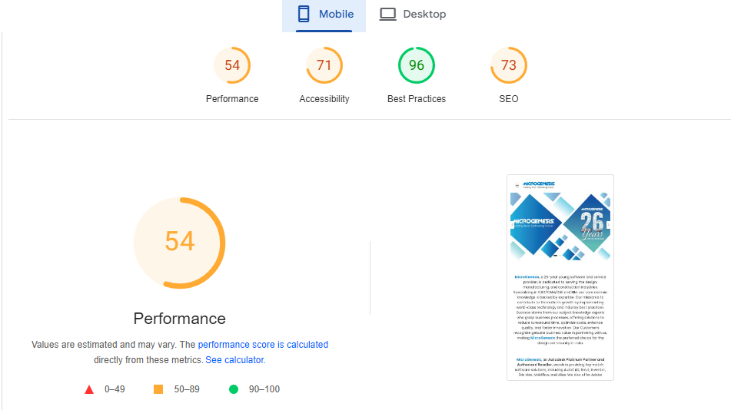
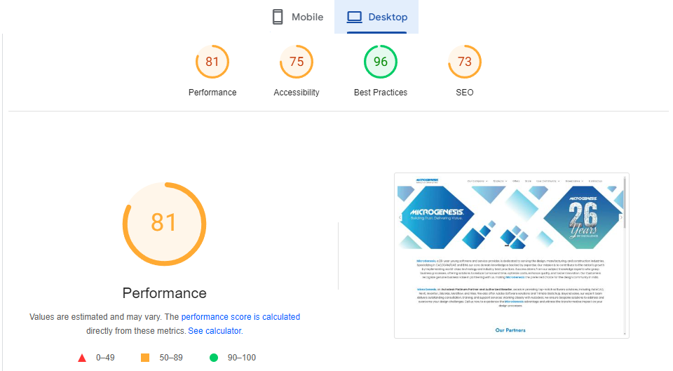
Optimized Loading Times
Issue:
Slow Loading time Components sizes are large
Solution:
Compress components with gzip.
Decreasing the number of components on a page reduces the number of HTTP requests required to render the page, resulting in faster page loads.
combine files, combine multiple scripts into one script, combine multiple CSS files into one style sheet, and use CSS Sprites and image maps.

Slide 36
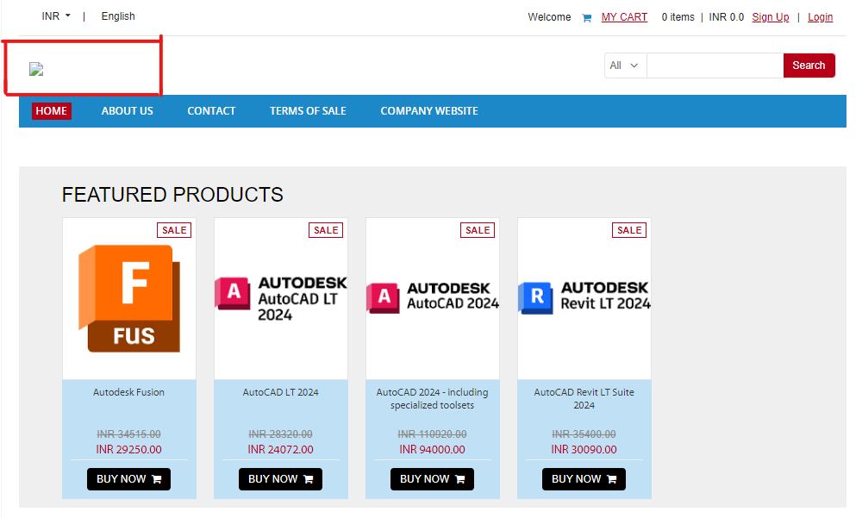
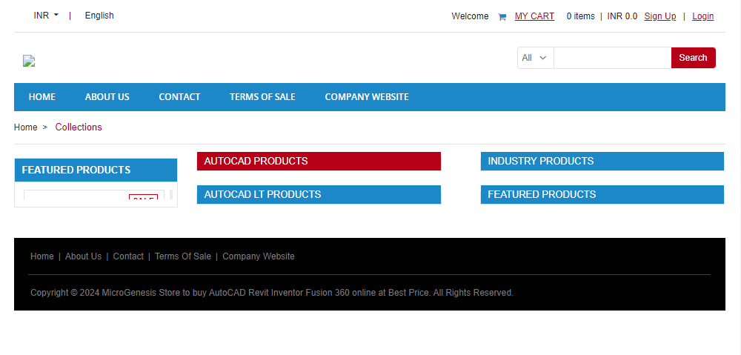
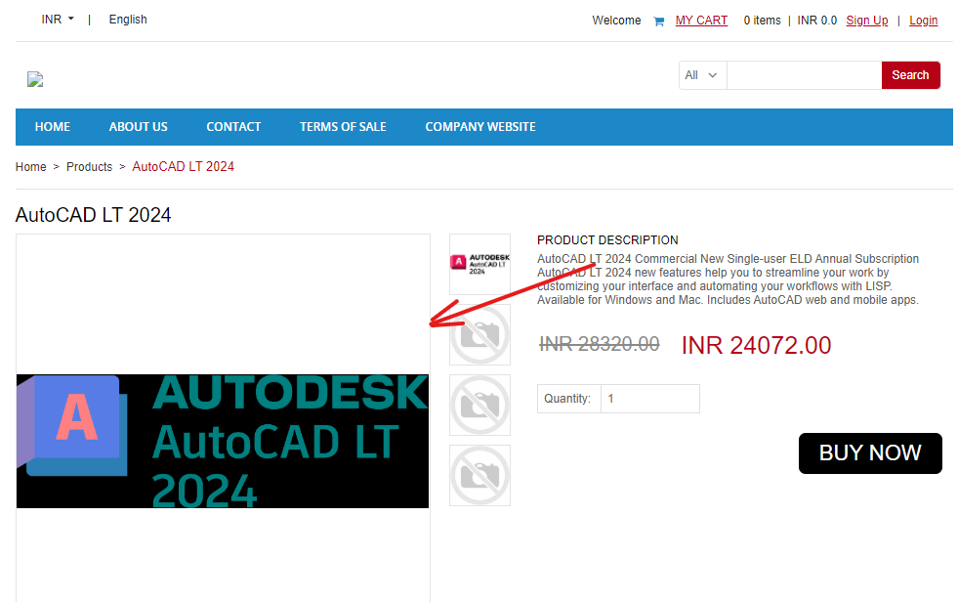
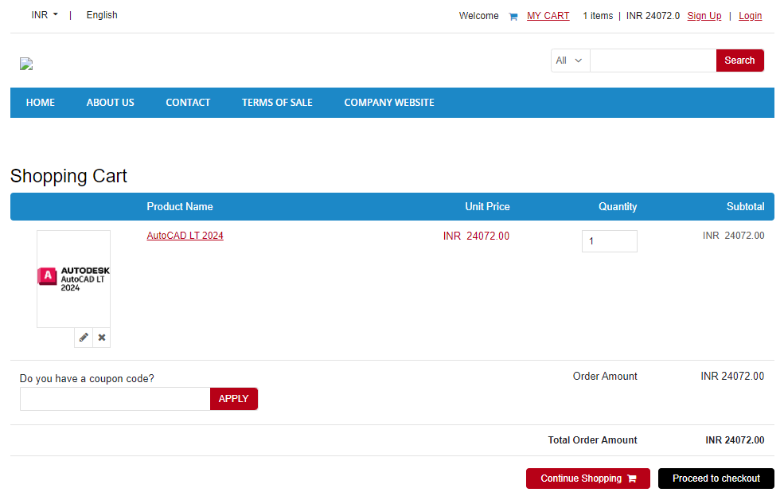
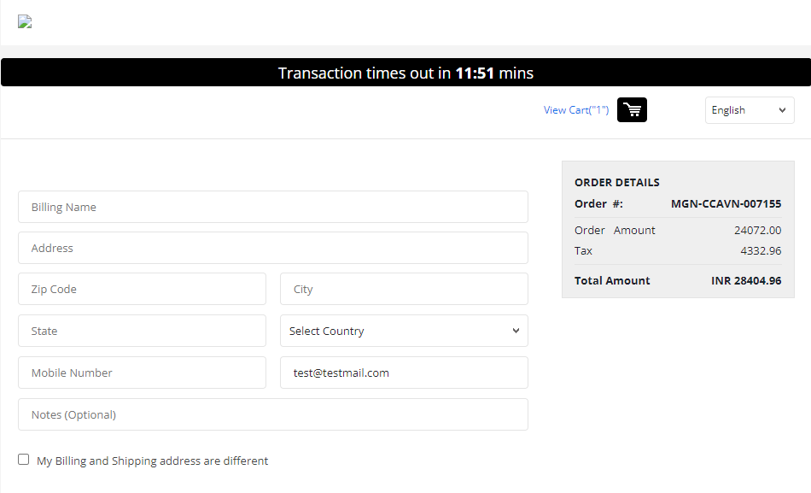
1
2
3
4
5
Mistakes:
In Store Page Logo Images not loading properly
Collection products feature not listed properly
Products Images having glitch issues.
Gst tax break up is not showing in cart portal.

Slide 37
Provide a list of best practices for creating visually appealing and user-friendly website designs

Slide 38
Clear Navigation
Simple and Intuitive: Ensure navigation is straightforward and easy to understand.
Consistent Layout: Keep the navigation layout consistent across all pages.
Visible and Accessible: Make navigation elements visible and accessible on all devices.
2. Responsive Design
Mobile-Friendly: Ensure the website is fully functional and visually appealing on mobile devices.
Flexible Grids and Layouts: Use flexible grids and layouts that adapt to different screen sizes.
Touch-Friendly Elements: Design buttons and interactive elements to be touch-friendly for mobile users.
3. Optimized Load Times
Compress Images: Use compressed images without compromising quality to reduce load times.
Minimize HTTP Requests: Limit the number of elements on each page to minimize HTTP requests.
Efficient Coding: Optimize CSS, JavaScript, and other code to improve loading speed.
4. Consistent Branding
Uniform Color Scheme: Use a consistent color scheme that reflects the brand identity.
Typography: Choose readable and consistent fonts that align with the brand.
Logo Placement: Position the logo in a prominent and consistent location, typically the top left corner.
5. Engaging Visuals
High-Quality Images: Use high-resolution images and videos.
Visual Hierarchy: Create a visual hierarchy to guide users' attention to the most important elements.
White Space: Use white space effectively to avoid clutter and enhance readability.

Slide 39
6. User-Centered Design
Understand Your Audience: Design with the target audience in mind, considering their needs and preferences.
Accessibility: Ensure the website is accessible to users with disabilities by following WCAG guidelines.
Feedback Mechanisms: Provide ways for users to give feedback on their experience.
7. Content Strategy
Relevant Content: Ensure content is relevant, valuable, and well-organized.
Clear Call-to-Actions (CTAs): Use clear and compelling CTAs to guide users towards desired actions.
Readability: Use short paragraphs, bullet points, and headers to make content easily scannable.
8. Search Engine Optimization (SEO)
Keywords: Use relevant keywords naturally within the content.
Meta Tags: Optimize meta titles and descriptions for better search engine visibility.
Alt Text: Use descriptive alt text for images to improve SEO and accessibility.
9. Testing and Feedback
Usability Testing: Conduct regular usability tests to identify and fix user experience issues.
A/B Testing: Use A/B testing to compare different design elements and determine what works best.
Continuous Improvement: Regularly update and improve the website based on user feedback and analytics.
10. Security and Privacy
Secure Connections: Use HTTPS to secure user data.
Privacy Policies: Clearly communicate privacy policies and data usage to users.
Regular Updates: Keep the website's software and plugins up to date to protect against vulnerabilities.

Slide 40
Design a landing page for their product or service to generate leads. (Use Mockup or Figma or Any other tools to show the design).

Slide 41

Tool Used

Slide 42
Click here for Landing Page

Slide 43
Thank You

